Slide 1

FileSystem Project
Using Makefiles and Catch2 for Automated Builds and Testing

Slide 2
Introduction:
Objective
The objective of this presentation is to explain the development and testing of a filesystem project. This project involves creating a simulated filesystem that includes operations such as creating, reading, writing, and deleting files, as well as managing directories. The focus will be on how to automate the build and testing process using Makefiles and the Catch2 testing framework.
Overview
The filesystem project is composed of several key components, each handling specific aspects of filesystem operations:
Directories:
Directory.h: Header file defining the Directory class and its interface.
Directory.cpp: Implementation file containing the functionality of the Directory class.
Filesystem Operations:
FileSystem.h: Header file defining the FileSystem class, which manages higher-level operations.
FileSystem.cpp: Implementation file for the FileSystem class.

Slide 3
Introduction:
3.Main Program:
main.cpp: The entry point of the program, which uses the FileSystem and Directory classes to demonstrate functionality.
4.Testing:
tests.cpp: Contains test cases written using the Catch2 framework to ensure the correctness of the filesystem operations.
These components work together to simulate a basic filesystem, allowing for the creation, manipulation, and deletion of files and directories. The use of Makefiles helps automate the compilation and linking process, while Catch2 provides a structured way to write and run tests to verify the system's functionality.

Slide 4
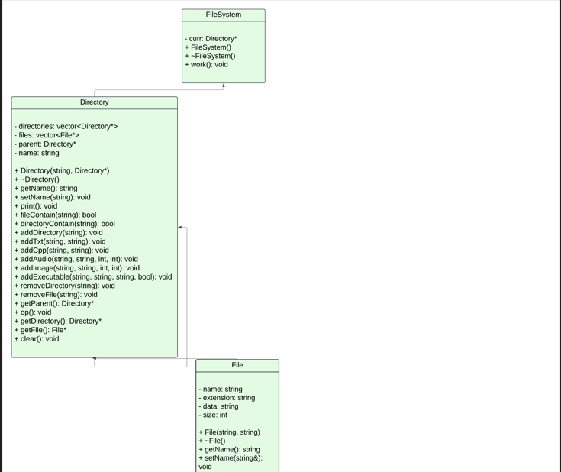
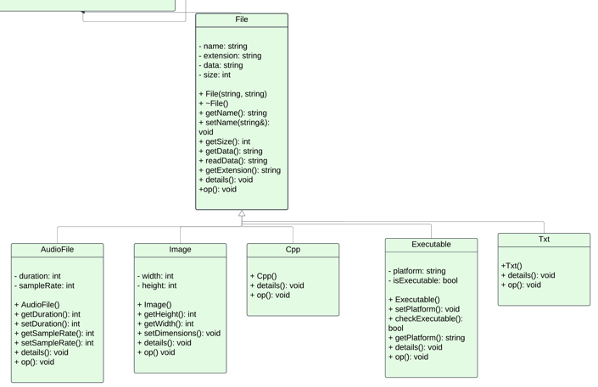

Slide 5
UML Diagram:
Class Diagram
Description:
The class diagram illustrates the structure of the classes within the filesystem project.
It shows the relationships between different classes, their attributes, and methods.
Key Components:
FileSystem Class:
Manages high-level filesystem operations such as creating, reading, writing, deleting files, and listing directory contents.
Contains methods like addDir(), removeDir(), and listContents().
Directory Class:
Represents directories within the filesystem.
Can contain files and other subdirectories.
Contains methods to add files (addFile()), remove files (removeFile()), and list the directory contents.

Slide 6
UML Diagram:
3.File Classes (e.g., Txt, Image, Audio, Cpp, Executable):
Represent different types of files.
Each file class inherits from a base File class which has common attributes and methods.
Specific file classes contain attributes and methods relevant to their file type, such as resolution for Image or
duration for Audio.

Slide 7
Implementation:
Approach
Translating Design into Code:
Class Implementation:
Started by implementing the FileSystem class as the main controller, responsible for high-level filesystem operations.
Created the Directory class to manage directories and their contents. This class can contain instances of File subclasses.
Developed specific File subclasses (Txt, Image, Audio, Cpp, Executable) inheriting from a base File class to encapsulate
file-specific attributes and methods.
Ensured proper use of inheritance and polymorphism to manage different file types efficiently.
File and Directory Operations:
Implemented methods for creating, reading, writing, deleting files, and listing directory contents in the FileSystem class.
In the Directory class, methods to add, remove files, and manage subdirectories were added to ensure smooth directory
operations.
Integration:
Integrated all classes and ensured they work together seamlessly.
Used the FileSystem class to coordinate actions and manage interactions between files and directories.

Slide 8
MakeFile:
Purpose:
The Makefile is used to automate the compilation and build process, ensuring that the project is compiled efficiently and correctly
every time.
Components:
Compiler and Flags:
Set the compiler (g++) and flags (-std=c++11 -Wall -MMD) to ensure the code is compiled with the C++11 standard and
all warnings are shown.
Directories:
Managed object files (obj) and source files directories for better organization.
Source Files:
Defined source files and their corresponding object files.
Dependencies:
Used dependency files (.d) to track header file changes, ensuring that changes in header files trigger recompilation of
affected source files.

Slide 9
MakeFile:
Targets:
Created separate targets for the main executable (FileSystem) and the test executable (tests).
Included rules to compile source files into object files and link them to create executables.
Clean Task:
Added a clean target to remove all generated files (obj directory, executables, dependency files) to maintain a clean
build environment.
Running the Makefile:
To compile the project, simply run the make command in the terminal. This will compile the source files and create the executable.
To clean the build environment, run make clean.

Slide 10
Benefits of MakeFile:
Automation:
Automates the compilation process, reducing manual errors.
Ensures that only changed files are recompiled, saving time.
Consistency:
Provides a consistent way to build the project across different environments and systems.
Dependency Management:
Automatically handles file dependencies, ensuring that changes in one part of the project trigger necessary recompilation of
dependent files.

Slide 11
Testing Approach:
Unit Testing:
Focused on testing individual components (classes and methods) of the filesystem to ensure they function correctly in isolation.
Integration Testing:
Ensured that different components of the filesystem work together as expected.
Test-Driven Development (TDD):
Wrote tests before implementing functionalities to guide development and ensure requirements are met.
Automated Testing:
Utilized Catch2 framework to automate the execution of tests and validation of results.

Slide 12
How the approach was applied:
Test Setup:
Set up the Catch2 testing framework to handle the creation and execution of tests.
Created a separate test file (tests.cpp) to contain all the test cases.
Unit Tests:
Created test cases for each class (Directory, File, and its subclasses) to verify their individual methods and functionalities.
Ensured that all edge cases and typical usage scenarios were covered.
Integration Tests:
Developed test cases that simulate real-world usage by combining different components.
Tested the interaction between Directory and File subclasses to ensure they work together as expected.
Automated Execution:
Integrated test execution into the Makefile to automate running tests during the build process.
Ensured that the tests run every time the project is built to catch any regressions early.

Slide 13
Details of Test Cases:
Files Creation Tests:
Objective: Verify that different types of files can be created and correctly identified within a directory.
Scenarios: Creating Txt, Image, Audio, Cpp, and Executable files and checking their presence in the directory.
Files Deletion Tests:
Objective: Ensure that files can be removed from a directory and are no longer accessible.
Scenarios: Adding multiple files, deleting them, and verifying they no longer exist in the directory.
Directories Creation Tests:
Objective: Confirm that subdirectories can be created and correctly identified within a parent directory.
Scenarios: Creating several subdirectories and checking their presence in the parent directory.

Slide 14
Details of Test Cases:
Directories Deletion Tests:
Objective: Verify that subdirectories can be deleted and are no longer accessible.
Scenarios: Adding multiple subdirectories, deleting them, and verifying they no longer exist in the parent directory.
Directories within Directories Tests:
Objective: Test the creation and navigation of nested directories.
Scenarios: Creating directories within directories, navigating between them, and ensuring the parent-child relationships are
maintained.
Files/Directories Modification Tests:
Objective: Ensure that file and directory attributes can be modified correctly.
Scenarios: Changing directory names, modifying file attributes (e.g., changing an Executable file's platform), and verifying the
changes.

Slide 15
Software Demonstration:
Understanding the Implementation
Project Structure:
The project is organized into source files (.cpp) and header files (.h), which define and implement the filesystem's functionality.
Key Components:
Directory Class: Manages directories and their contents (files and subdirectories).
Methods: addTxt, addImage, addAudio, addCpp, addExecutable, removeFile, addDirectory, removeDirectory, fileContain,
directoryContain.
File Class: Base class for various file types, providing common attributes and methods.
Subclasses of File: Txt, Image, Audio, Cpp, Executable, each representing a specific file type with unique attributes.

Slide 16
Software Demonstration:
3.Code Walkthrough:
Directory.cpp and Directory.h:
Demonstrate how directories are created, files are added/removed, and subdirectories are managed.
File and Subclasses:
Show how different file types inherit from the base File class and implement their specific attributes and methods.
Tests.cpp:
Highlight the test cases implemented to validate the functionality of the filesystem.

Slide 17
MakeFile Explanation:
Purpose of Makefile:
Automates the build process, ensuring that the source files are compiled and linked correctly.
Simplifies the compilation of the project and execution of tests by providing predefined commands.
Key Sections of the Makefile:
Compiler and Flags:
Defines the compiler (g++) and compilation flags (-std=c++11 -Wall -MMD).
Directories and Files:
Specifies source directories, object directories, and source files.
Rules:
$(EXEC): Compiles the main executable.
$(TEST_EXEC): Compiles the test executable.
$(OBJDIR)/%.o: Compiles individual object files from source files.
$(OBJDIR): Ensures the object directory exists.
Clean Task:
Provides a command to clean up compiled files and dependencies.
Example Commands:
mingw32-make: Compiles the entire project.
mingw32-make clean: Cleans up compiled files.

Slide 18
MakeFile Explanation:
Demonstration of Functionality
Creating and Managing Files:
Create a Directory: Instantiate a Directory object.
Add Files: Use methods like addTxt, addImage, etc., to add various files to the directory.
Remove Files: Demonstrate removing files using removeFile.
List Contents: Show the directory's contents to verify the addition and removal of files.
Creating and Managing Subdirectories:
Add Subdirectories: Use addDirectory to create nested directories.
Remove Subdirectories: Use removeDirectory to delete nested directories.
Navigate: Demonstrate navigating between directories and listing their contents.
Modifying Attributes:
Change File/Directory Attributes: Use methods to change attributes like names and file-specific properties.
Verify Changes: Show the modified attributes to verify the changes were successful.

Slide 19
Conclusion:
Summary of the Work
In this project, I developed a comprehensive filesystem simulation that allows users to create, manage, and manipulate files and directories in a structured manner. I designed the system using object-oriented principles, encapsulating different types of files and directories into distinct classes. The implementation included various file operations such as creation, deletion, and modification, along with directory management functions. Testing was conducted using Catch2 to ensure the correctness and robustness of the system.
Limitations of the Work
Error Handling: The current implementation has limited error handling. For example, it does not gracefully handle cases where operations are performed on non-existent files or directories.
Scalability: The system is not optimized for large-scale operations, such as handling thousands of files and directories efficiently.
Concurrency: The current design does not support concurrent access and modifications to the filesystem, which could be an issue in a multi-user environment.
User Interface: There is no graphical user interface (GUI) or command-line interface (CLI) for users to interact with the filesystem easily.

Slide 20
Conclusion:
Future Approaches to Avoid Limitations
Enhanced Error Handling: Implement robust error handling mechanisms to manage invalid operations and provide meaningful feedback to the user.
Performance Optimization: Optimize data structures and algorithms to improve performance for large-scale filesystem operations.
Concurrency Control: Introduce mechanisms for concurrent access and modification, such as implementing locking mechanisms or using concurrent data structures.
User Interface Development: Develop a user-friendly GUI or CLI to make the filesystem more accessible and easier to use.
Testing and Validation: Expand the test suite to cover edge cases and stress-test the system to ensure reliability and stability under various conditions.

